Slide 1
Average Salary :: 1898.73$

Slide 2
 | BALANCE | GENDER | AGE | AMOUNT
BALANCE | 1 | -0.14 | 0.19 | 0.29
GENDER | -0.14 | 1 | -0.03 | -0.18
AGE | 0.19 | -0.03 | 1 | -0.14
AMOUNT | 0.29 | -0.18 | -0.14 | 1

Slide 3
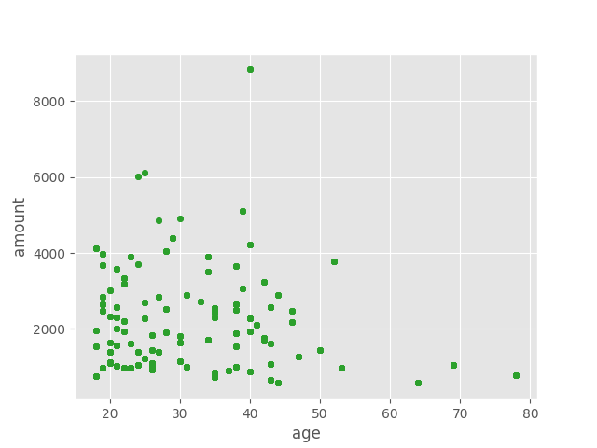

Slide 4
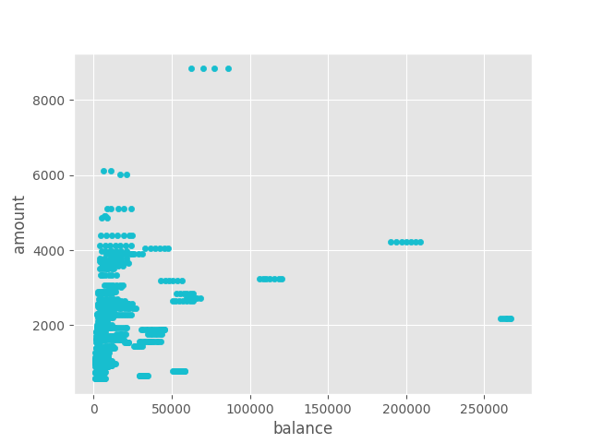

Slide 5
import pandas as pd
from sklearn.linear_model import LinearRegression
from sklearn.model_selection import train_test_split
from sklearn.metrics import mean_squared_error
import matplotlib.pyplot as plt
data_file = 'data.csv'
df = pd.read_csv (data_file)
df=df[df["txn_description"]=="PAY/SALARY"]
df.drop(['customer_id','transaction_id','long_lat','merchant_code','currency','movement','extraction','bpay_biller_code','country','merchant_long_lat','status','card_present_flag','merchant_suburb','merchant_state','date','txn_description','first_name','merchant_id'],axis='columns', inplace=True)
X2=df[['age','balance']]
Y=df['amount']
X_tr,X_ts,Y_tr,Y_ts=train_test_split(X2,Y,test_size=0.3,random_state=1)
model=LinearRegression()
model.fit(X_tr,Y_tr)
Y_predicted=model.predict(X_ts)
print("A>> ",mean_squared_error(Y_ts,Y_predicted).round(2))
print(model.score(X_ts,Y_ts))

Slide 6
Accuracy : 30%
I would not recommend a inear regression model on this. As the data correlation is very low

